Slide 1
Ding, Xiao, et al. "Deep learning for event-driven stock prediction.“
Twenty-fourth international joint conference on artificial intelligence. 2015.
Abstract
Event-driven stock market prediction
1) Events are extracted from news text, and represented as dense vectors, trained using a novel neural tensor network.
2) A deep convolutional neural network is used to model both short-term and long-term influences of events on stock price movements.
→ Experimental results show that our model can achieve nearly 6% improvements on S&P 500 index prediction and individual stock prediction, respectively, compared to state-of-the-art baseline methods. In addition, market simulation results show that our system is more capable of making profits than previously reported systems trained on S&P 500 stock historical data.

Slide 2
Introduction
It has been shown that the financial market is “informationally efficient” [Fama, 1965] — stock prices reflect all known information, and the price movement is in response to news or events.
As web information grows, recent work has applied Natural Language Processing (NLP) techniques to explore financial news for predicting market volatility.
Pioneering work mainly uses simple features from news documents, such as bags-of-words, noun phrases, and named entities [Kogan et al., 2009; Schumaker and Chen, 2009]. Although useful, these features do not capture structured relations, which limits their potentials.
Ex) {“Microsoft”, “sues”, “Barnes”, “Noble”} the accuser (“Microsoft”) and defendant (“Barnes & Noble”).``
Using open information extraction (Open IE) to obtain structured events representations, we find that the actor and object of events can be better captured [Ding et al., 2014].
Ex) (Actor = Microsoft, Action = sues, Object = Barnes & Noble).
We propose to address this issue by representing structured events using event embeddings, which are dense vectors. Embeddings are trained such that similar events.

Slide 3
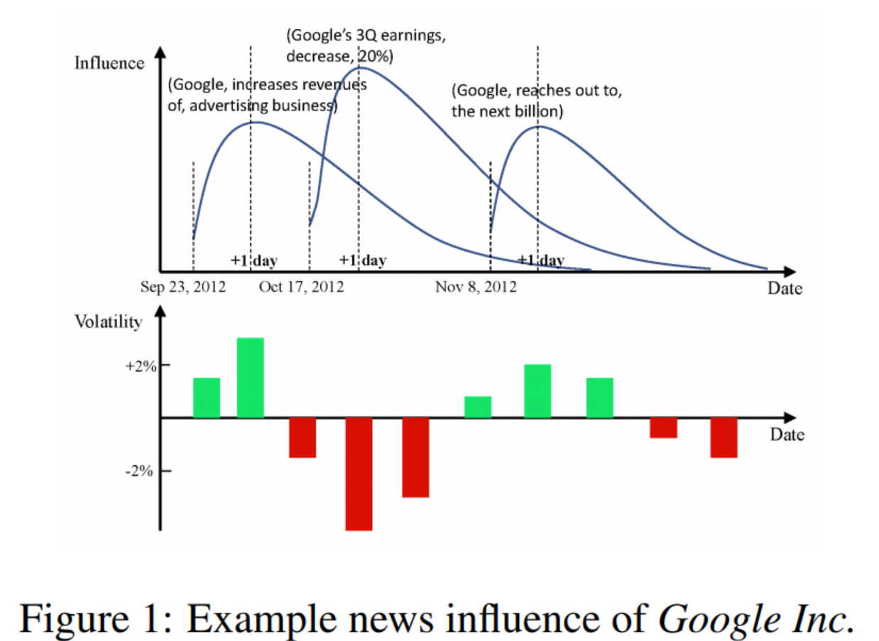
Introduction
For the predictive model, we propose to use deep learning [Bengio, 2009] to capture the influence of news events over a history that is longer than a day.
As shown in Figure 1, the influences of three actual events for Google Inc. in the year 2012 was the highest on the second day, but gradually weakened over time. Despite the relatively weaker effects of long-term events, the volatility of stock markets is still affected by them.
However, little previous work quantitively models combined short-term and long-term effects of events.
To fill in this gap, we treat history news as daily event sequences, using a convolutional neural network (CNN) to perform semantic composition over the input event sequence, and a pooling layer to extract the most representative global features.
Then a feedforward neural network is used to associate the global features with stock trends through a shared hidden layer and a output layer.

Slide 4
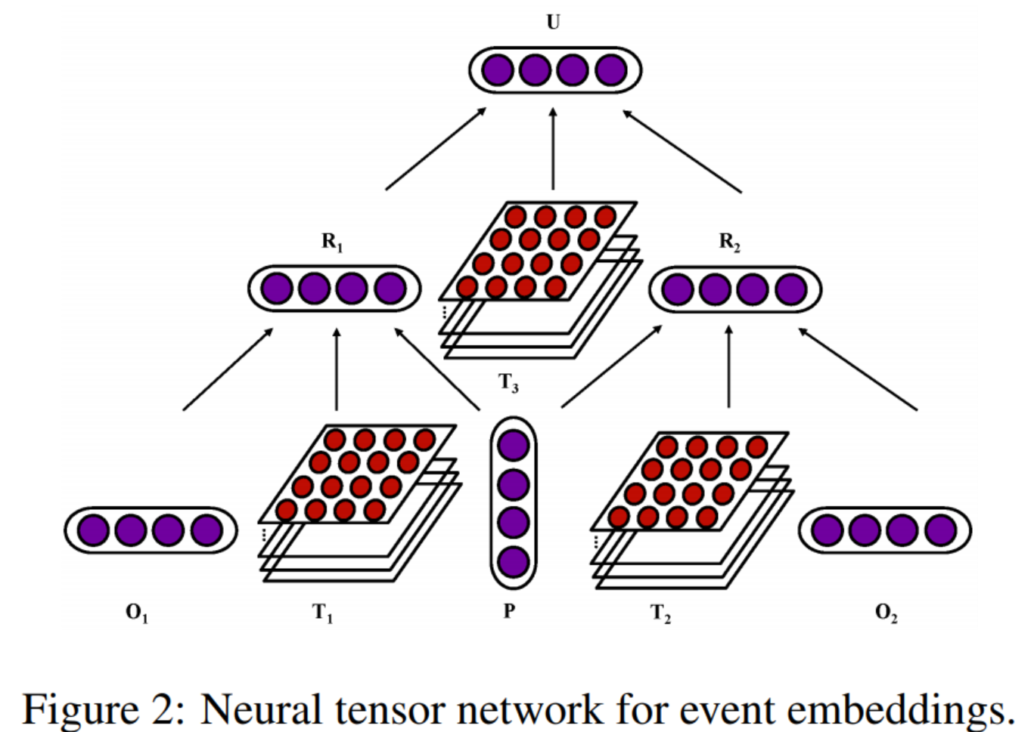

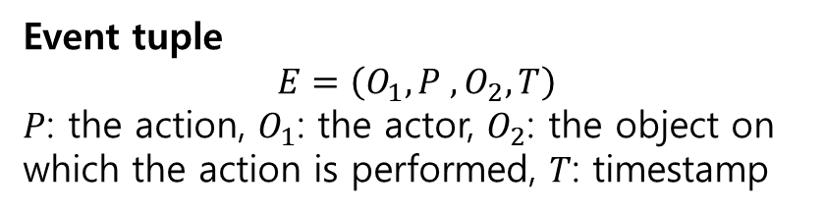
2. Neural Tensor Network for Learning Event Embeddings
Event tuple
$$E=\left(O_{1}, P ,O_{2}, T\right)$$
$P$: the action, $O_{1}$: the actor, $O_{2}$: the object on which the action is performed, $T$: timestamp
f: activation function, W : weight matrix, b: bias vector
Actor
Time
Action
Time
Object
(Actor = Google, Action = acquires, Object = Nest, Time: Jan 13, 2014)

Slide 5
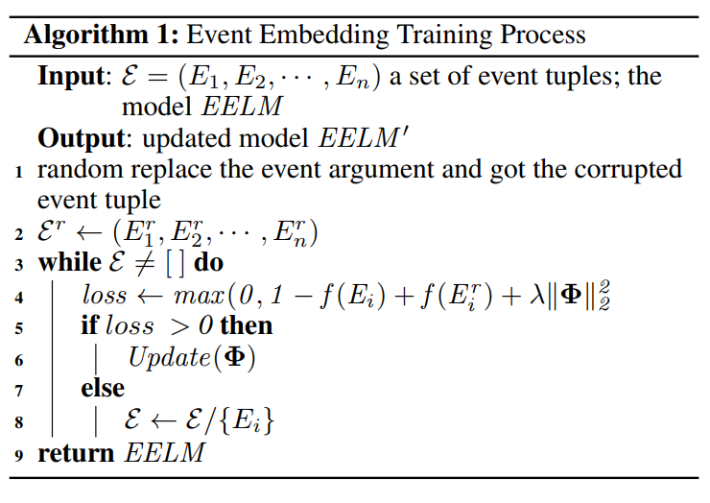

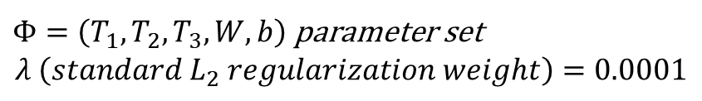
Training
We extract more than 10 million events from Reuters financial news and Bloomberg financial news as the training data for event embeddings.
→ The training algorithm repeats for
N iterations over the training examples
In each iteration, the training procedure is shown in Algorithm 1.
Assumption
event tuples in the training set should be given a higher score than corrupted tuples
Margin Loss
$Φ=\left(T_{1},T_{2},T_{3},W,b\right)$ parameter set $$λ \left(standard L_{2} regularization weight\right)=0.0001$$
Loss = 0 → algorithm continues next tuple
Otherwise, the parameters are updated to minimize the loss using BP

Slide 6
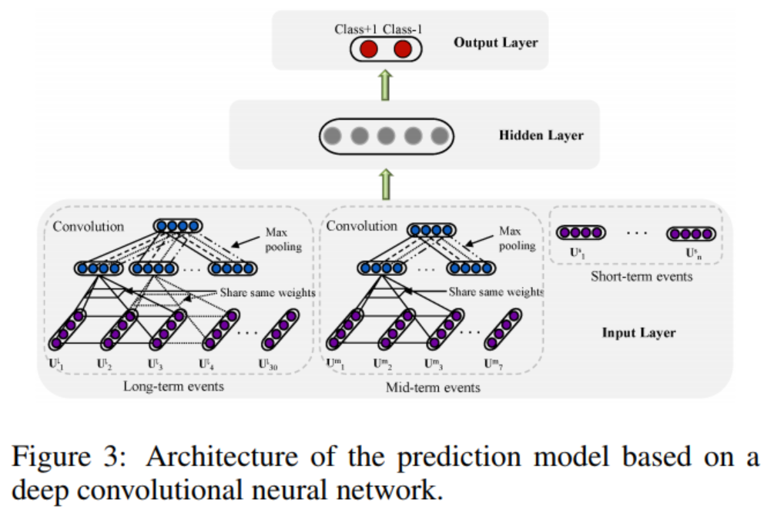
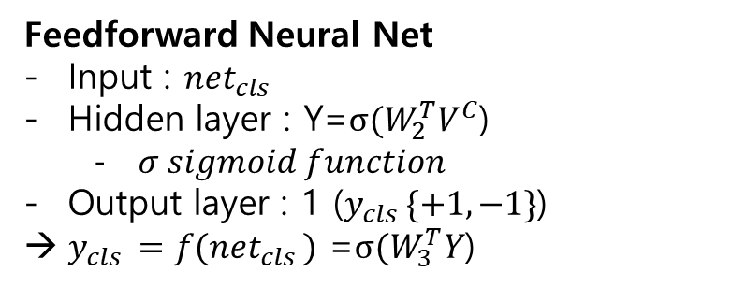


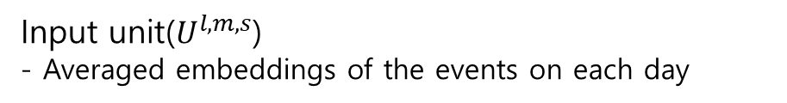
3. Deep Prediction Model
Binary class: Stock price will increase(+1) or decrease(-1)
$V_{j}$=max $Q(j,〮)$
$Q_{j}=W_{1}^{T}U_{j−l+1:j}$ → To determine the most representative features globally, we perform a max pooling operation over Q.
$$V^{C(l,m,s)}$$
Feedforward Neural Net
Input : ${net}_{cls }$
Hidden layer : Y=$σ(W_{2}^{T}V^{C}$)
$σ sigmoid function$
Output layer : 1 ($y_{cls }\{+1,−1\}$)
$y_{cls }=f({net}_{cls })$ =$σ(W_{3}^{T}Y$)
Input unit($U^{l,m,s}$)
- Averaged embeddings of the events on each day

Slide 7
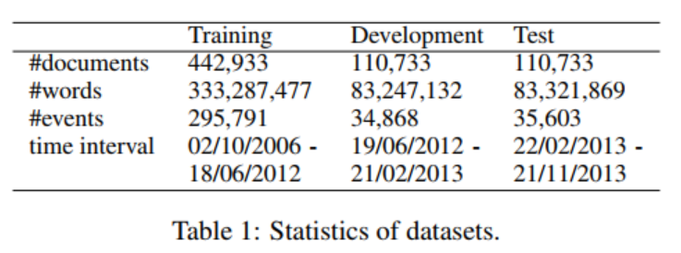
4. Experiments
Experimental settings
Financial news from Reuters and Bloomberg : 2006.10.~ 2013.11. released by Ding et al. [2014]
Predicting S&P500 index, its individual stocks
Evaluation : the standard measure of accuracy (Acc) and Matthews Correlation Coefficient (MCC)
Baselines and Proposed Models
Luss and d’Aspermond : Using bags of words to represent news and constructing the prediction model by using SVM
WB-NN : Word embeddings input and standard neural network prediction model (Ding et al. 2014)
WB-CNN : Word embeddings input and convolutional neural network prediction model (this paper);
E-CNN : Structured events tuple input (Ding et al. 2014) and convolutional neural network prediction model (this paper);
EB-NN : Event embeddings input (this paper) and standard neural network prediction model (Ding et al. 2014)
EB-CNN : Event embeddings input and convolutional neural network prediction model (this paper).

Slide 8
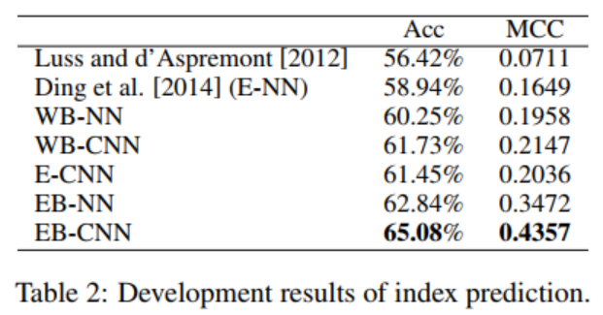
4.3 Development results
S&P 500 Index prediction
(1) Comparison between the word-embedding-based models and event-embedding-based models (e.g. WB-NN vs EB-NN and WB-CNN vs EB-CNN) confirms our previous conclusion [Ding et al., 2014]: Events are better features than
words for stock market prediction.
(2) Event embedding is useful for the task of stock market prediction. Given the same prediction model (CNN or NN),
the event embeddings based methods (EB-NN and EB-CNN) achieve consistently better performance than the events-based methods (E-NN and E-CNN).
- First, low-dimensional dense vector can effectively alleviate the problem of feature sparsity.
- Second, we can learn deeper semantic relations between event embeddings, by modeling the semantic compositionality over word embeddings.
(3) CNN-based prediction models are more powerful than NN-based prediction models (e.g. WB-CNN vs WB-NN, EB-CNN vs EB-NN, and E-CNN vs E-NN). This is mainly because CNN can quantitively analyze the influence of the history events over longer terms, and can extract the most representative feature vector for the prediction model.

Slide 9
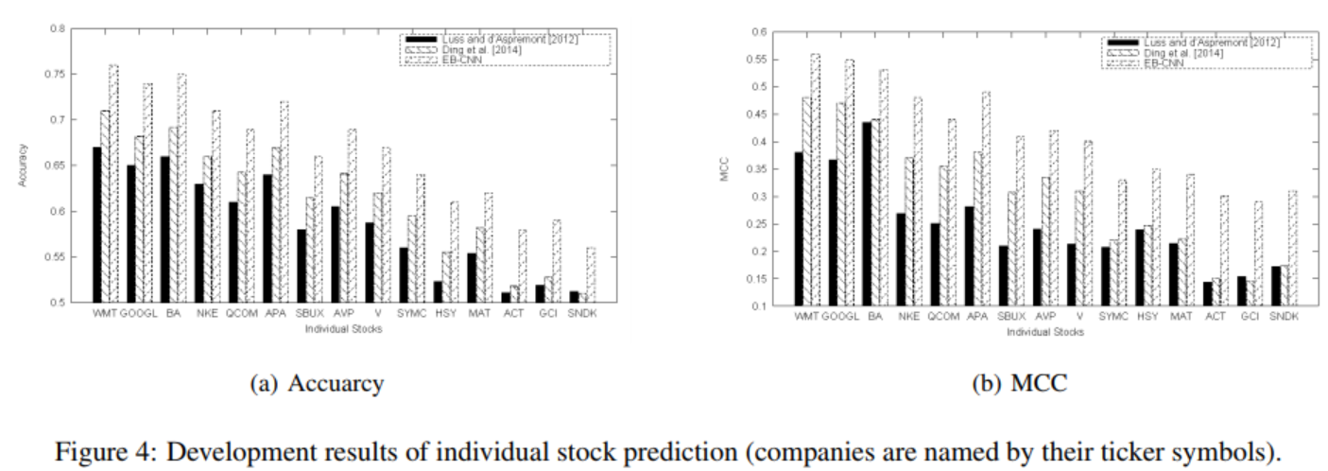
4.3 Development results
Individual stock prediction
Our model achieves consistently better performance compared to the baseline methods, on both individual stock prediction and S&P 500 index prediction.
Our model achieves relatively higher improvements on those lower fortune ranking companies, for which fewer news are available. For the baseline methods, the prediction results of low-ranking companies dramatically decrease. However, our model considers the diminishing influence of monthly news and weekly news, which are important features for individual stock prediction. Hence, even without daily news, our model can also give relatively accurate prediction results.

Slide 10
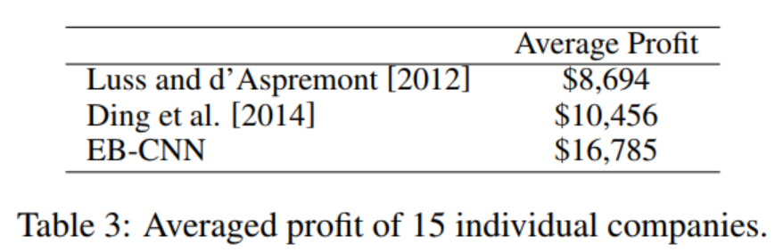
4.3 Development results
Market Simulation
We simulate real stock trading by following the strategy proposed by Lavrenko et al. [2000], which mimics the behavior
of a daily trader who uses our model in a simple way.
We use the same training, development and test dataset as shown in Table 1, for the simulation. Table 3 summarizes the average cumulative profits over the 15 companies in Section 4.3.

Slide 11
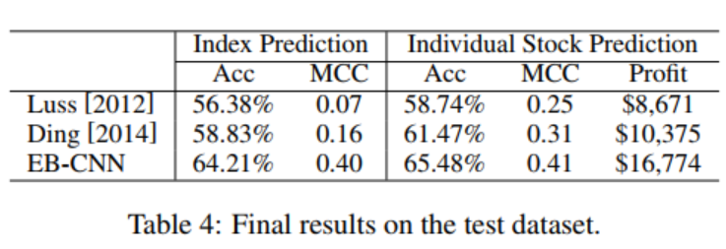
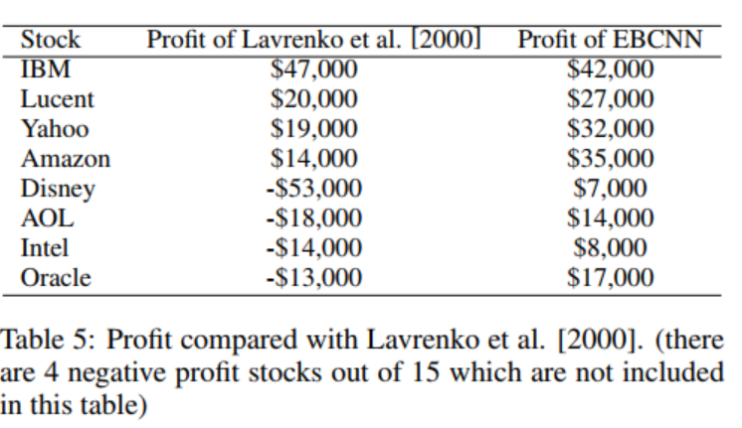
4.4 Final results
Table 4 shows the final experimental results on the test dataset, where Luss [2012] is the model of Luss and d’Aspremont [2012] and Ding [2014] is the model of our previous work
Market Simulation
To compare with Lavrenko et al. [2000], Table 5 shows the profit for eight companies (i.e., IBM, Lucent, Yahoo, Amazon, Disney, AOL, Intel and Oracle) selected by them. We use for training data news between October and December 1999, and for test data news of 40 days starting on January 3rd, 2000, which is the same with Lavrenko et al. [2000]. Except for IBM, we achieve consistently better performance.

Slide 12
6. Conclusion
We demonstrated that deep learning is useful for event-driven stock price movement prediction by proposing a novel neural tensor network for learning event embeddings, and using a deep convolutional neural network to model the combined influence of long-term events and short-term events on stock price movements.
Experimental results showed that event embeddings-based document representations are better than discrete events-based methods, and deep convolutional neural network can capture longer-term influence of news event than standard feedforward neural network.
In market simulation, a simple greedy strategy allowed our model to yield more profit compared with previous work.
Neural Tensor Network에 대한 논문
Socher, Richard, et al. "Reasoning with neural tensor networks for knowledge base completion." Advances in neural information processing systems. 2013.

